Slide 1
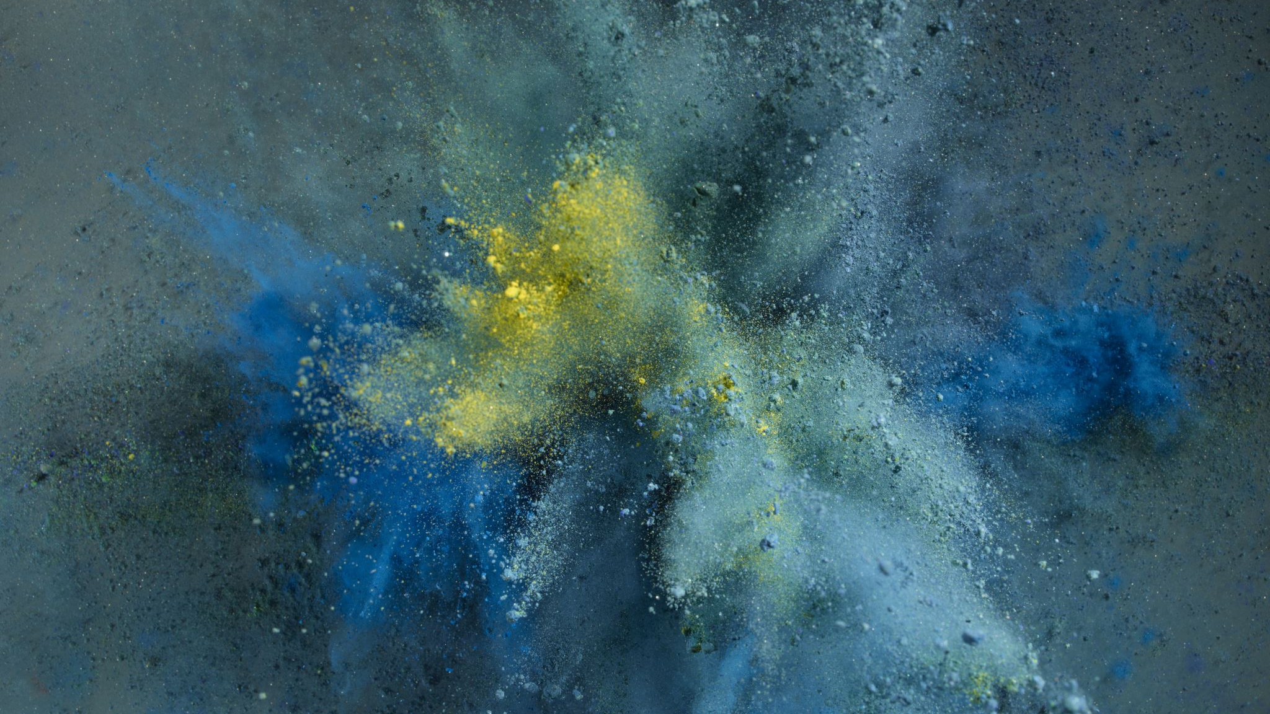



OLD CRAFTS, SIGHTS, FOOD AND HISTORY IN SPAIN AND IN GUADALAJARA
C.E.I.P. OCEJON

Slide 2
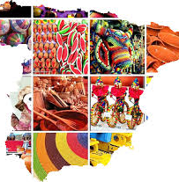
Spanish crafts are the result of the several cultures and Civilization that have had place in the Iberian Peninsula.
Each region has a wide cultural diversity as well as a lot of different Jobs, that had emerged according to this fact.

Slide 3
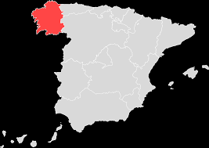
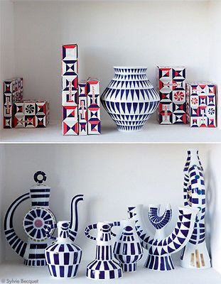
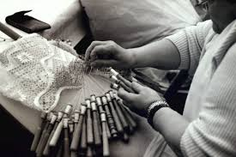
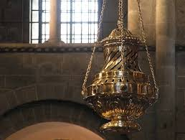
GALICIA
Galician crafts have an international appreciation as well as a deep tradition among its citizens. During the 20th century the production of this materials suffer a great decrease. It was solve with the creation of “Rexistro Xeral de Artesanía de Galicia “in 1994.

Slide 4
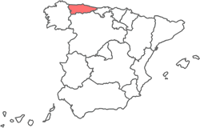
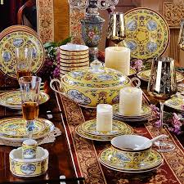
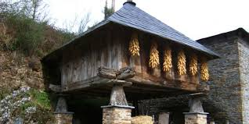
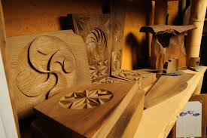
ASTURIAS
Asturian crafts are older than the Roman Empire invasion.

Slide 5
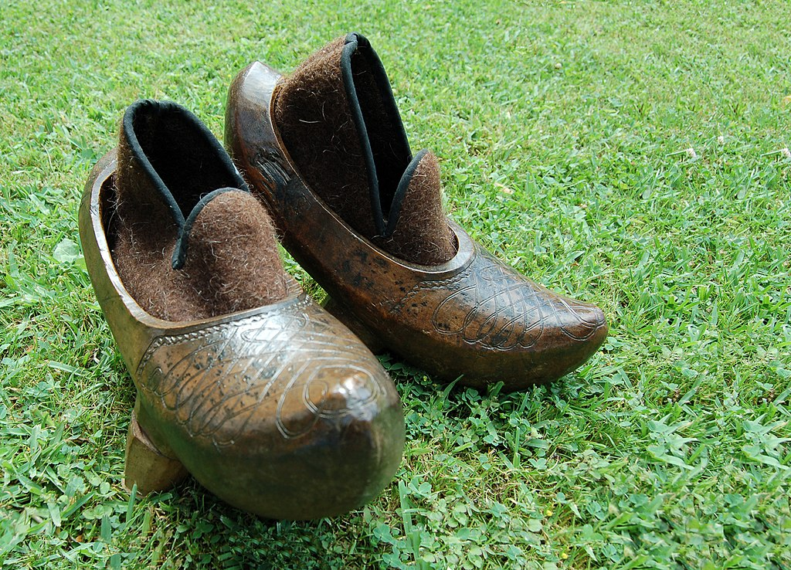
CANTABRIA
Cantabric crafts are based on wooden elaborations.

Slide 6
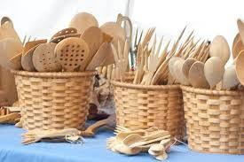
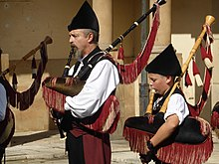
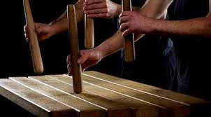
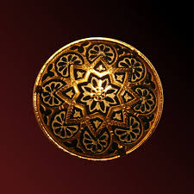
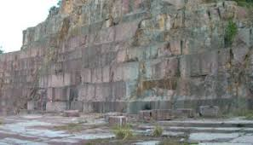
The first curiosity of Vasque crafts is the production of traditional instruments as the Txalaparta and the Gaita.
VASQUE COUNTRY

Slide 7
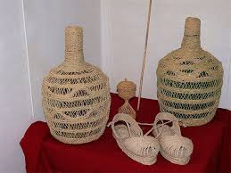
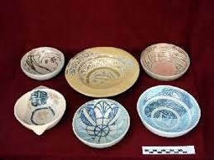
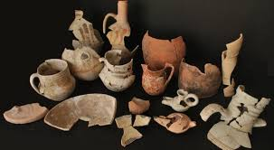
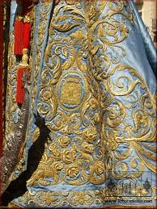
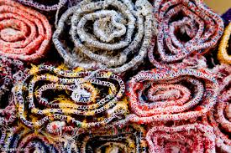
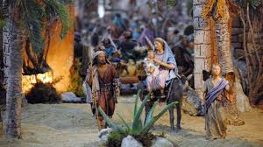
At Lorca we can found the manufacture of jarapas and gold and silk embroidery (shown on Easter).
MURCIA

Slide 8
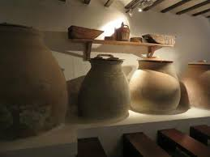
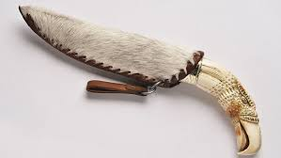
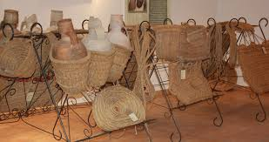
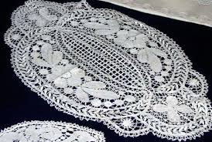
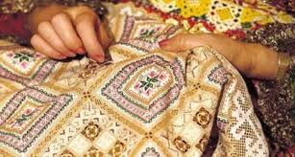
CASTILLA LA MANCHA

Slide 9
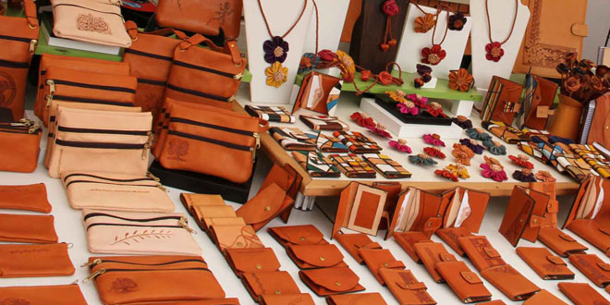
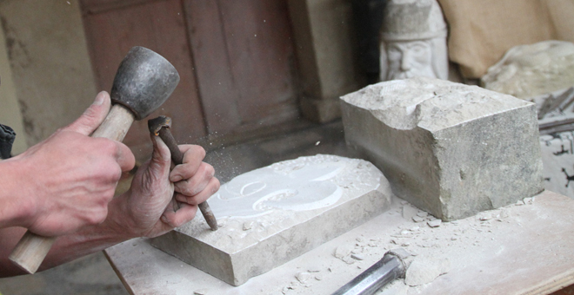
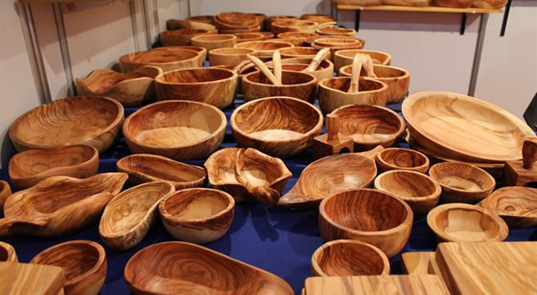
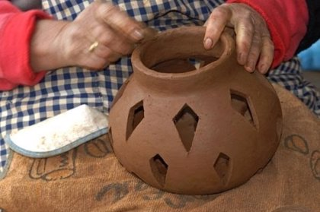
CRAFT IN GUADALAJARA(GUADALAJARA BELONGS TO CASTILLA LA MANCHA REGION)

Slide 10



COASTAL SIGHTS IN SPAIN
SPAIN IS SURROUNDED BY SEAS. THIS IS WHY WE HAVE LOVELY COASTAL SIGHTS.

Slide 11
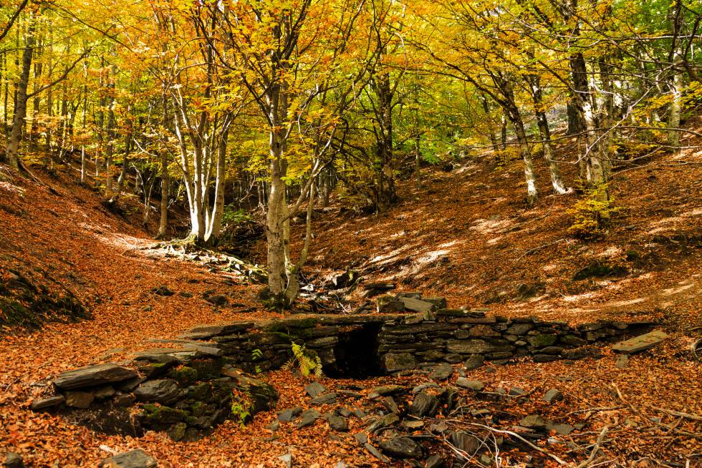
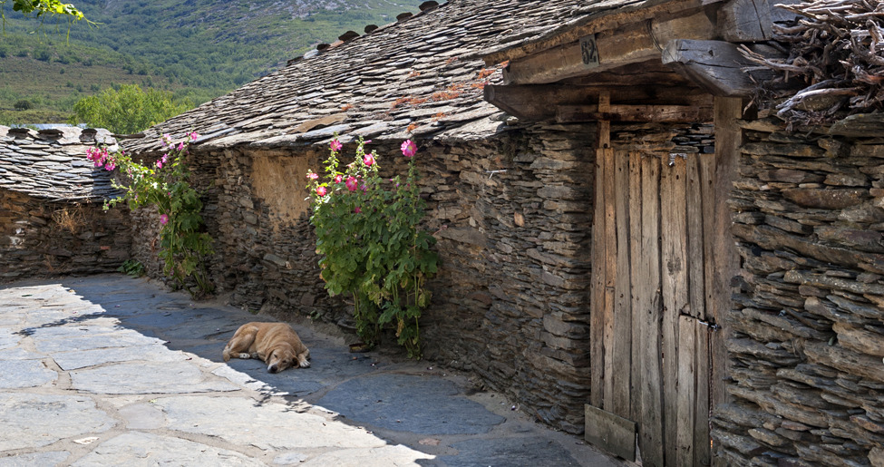
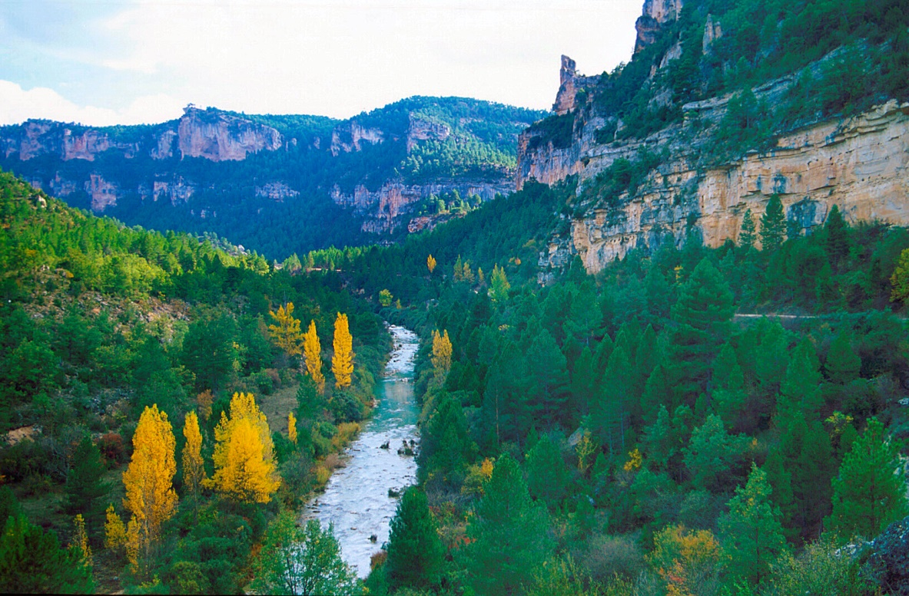
GUADALAJARA IS AN INLAND AREA
Guadalajara has not sea, but it has really nice sight in its province

Slide 12
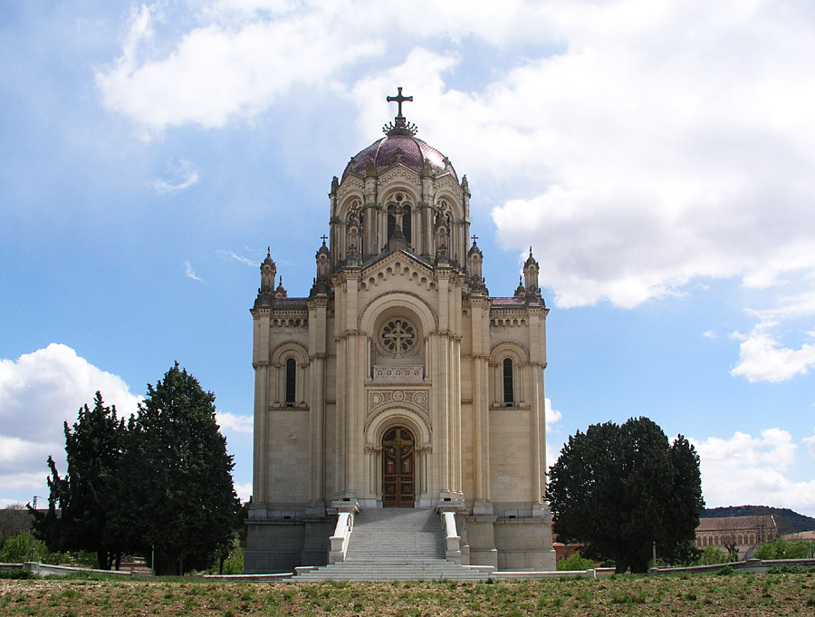
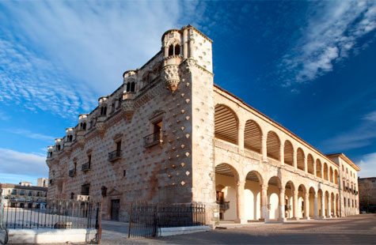
THE CITY OF GUADALAJARA
HERE YOU HAVE THE MOST BEAUTIFUL BUILDINGS.

Slide 13
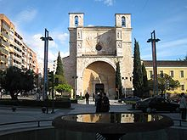
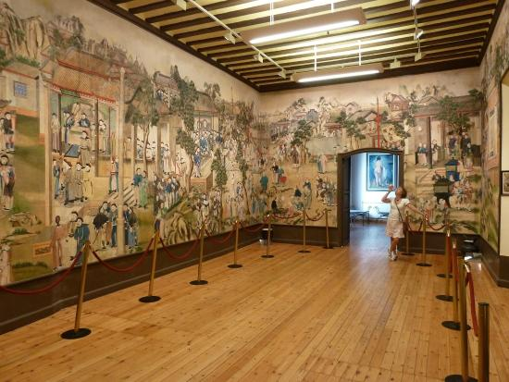
MORE IMPORTANT BUILDINGS

Slide 14
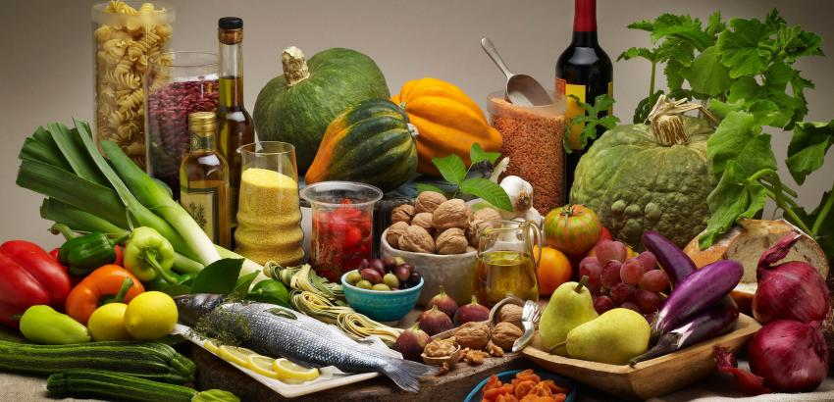
FOOD IN SPAIN
BECAUSE OUR CLIMATE WE HAVE A GOOD VARIETY IN ALL THE PRODUCTS, VEGETABLE MEAT , FISH, SEAFOOD….YUMM YUMMY. WE HAVE A FAMOUS MEDITERRANEAN DIET.

Slide 15
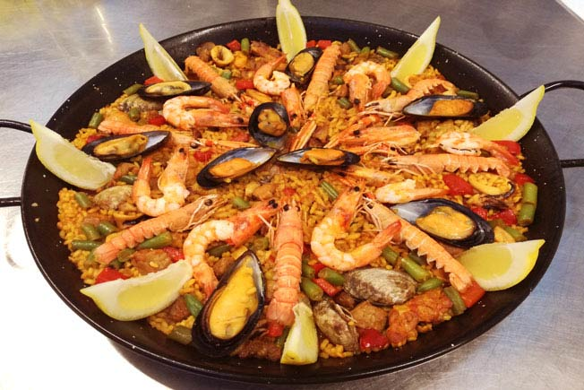
TYPICAL DISHES IN SPAIN
THE MOST FAMOUS DISH IN THE WPRD IS OUR PAELLA

Slide 16
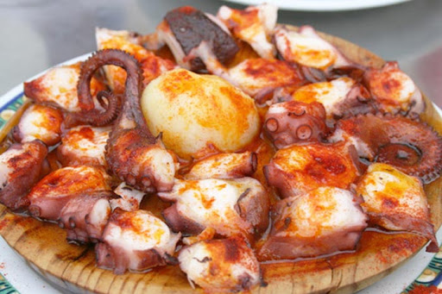
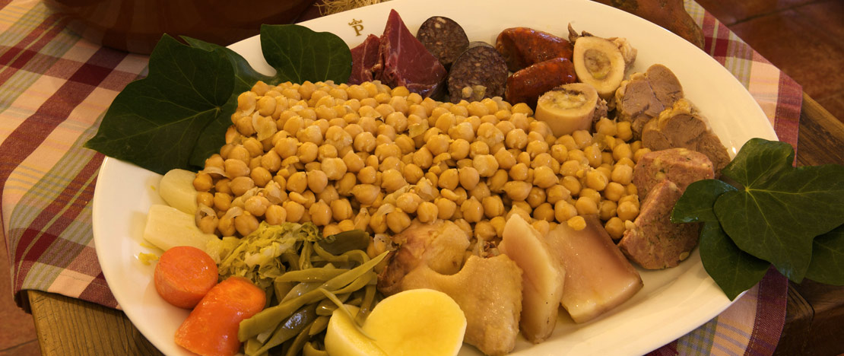
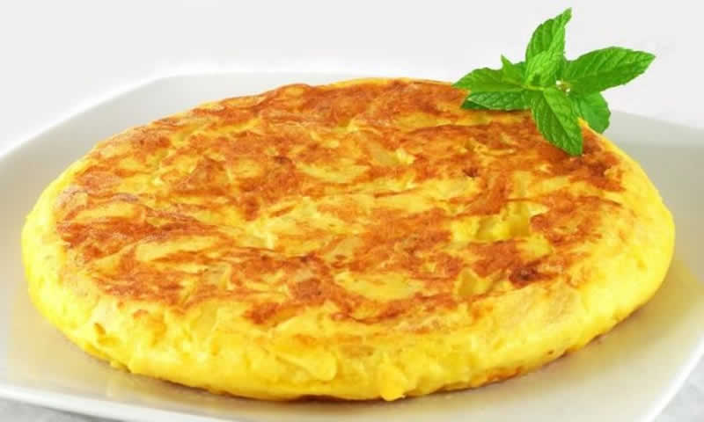
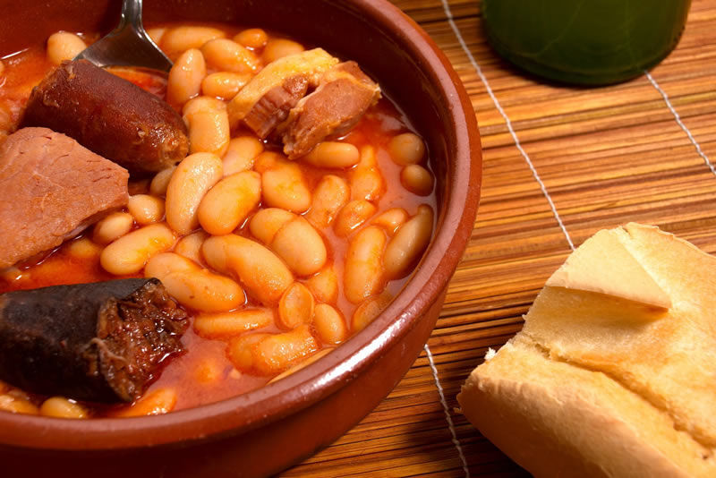
OTHER TYPICAL SPANISH DISHES

Slide 17
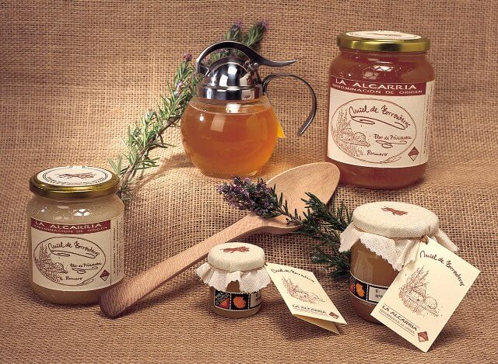
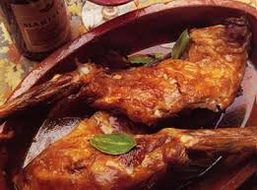
THE MOST IMPORTANT PRODUCTS IN GUADALAJARA.
HONEY
LAMB

