Slide 1


DARE TO SHARE

Slide 2
Christmas in Spain
Spanish traditions that you need to know

Slide 3
Each year between December 24 and January 6, Spain comes alive to celebrate Christmas, or Navidad in Spanish. During this time of the year, everyone strives to fill their days with happiness, joy, and family harmony, although some are more successful than others.
Spanish holidays are a mixture of Christian and pagan traditions. According to Catholic tradition, Christmas is celebrated on December 25 in honor of the day Jesus was born. December 31 is New Year’s Eve, or Nochevieja in Spanish, the time to say goodbye to the year that’s coming to an end and welcome the new year. But the holiday season doesn’t end there! January 6 is a very important holiday in Spain called el Día de los Tres Reyes Magos (known in English as Epiphany or Three Kings’ Day).

Slide 4
El gordo
Although Christmas Eve isn’t until December 24, Christmas always comes to Spain a few days early, on December 22. That’s the day the winning numbers of the hugely popular Spanish Christmas Lottery are drawn and announced in song by schoolchildren on live TV. In the months leading up to this event, many Spaniards buy lottery tickets and wait to see if their number will be lucky that year.
Once the lottery prizes have been announced, the holidays have officially started, and everyone starts making final preparations for the big celebrations.

Slide 5
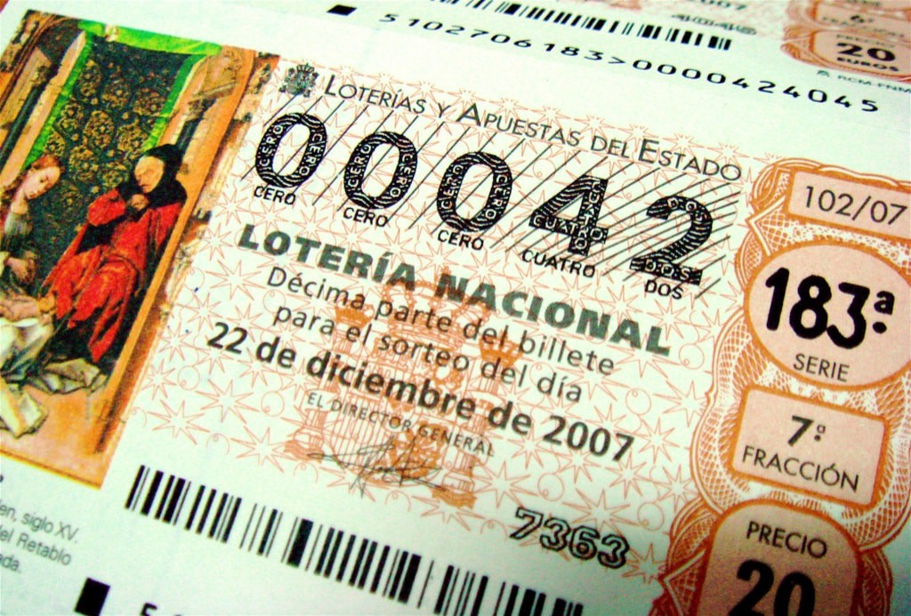
The Christmas Lottery is so big that it has been given the nickname ‘El Gordo’ or the ‘Fat One’, because of the huge amounts of cash you can win. Taking place on December 22, it has been held every year since 1812

Slide 6
BELÉN
Beléns are elaborate nativity scenes – it is the Spanish word for Bethlehem. More than just a stable with animals and figurines, however, the Spanish beléns can be huge scenes, complete with many different houses, farms, rivers and marketplaces. The Spanish often set one of these up in their homes in the lead up to Christmas, but much larger ones are placed in shop windows or town squares.

Slide 7
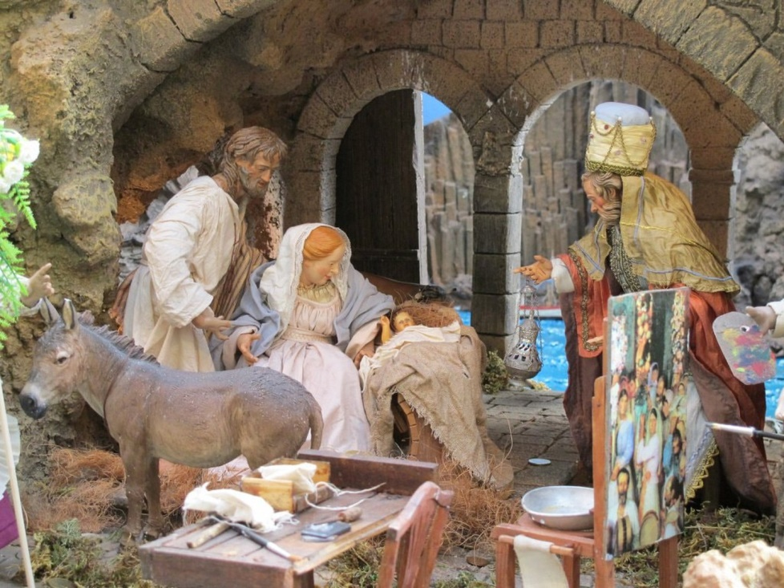
El belén

Slide 8
Nochebuena misa del gallo
Christmas Eve, or Nochebuena in Spanish, is celebrated on December 24 and is generally a family affair. Usually, members of the extended family gather around a feast of meat, wine, typical foods not eaten at other times of the year, and all kinds of desserts, specially turrón and polvorones.
For devout Catholics, there’s an important event after dinner: it’s time to go to a special midnight mass called the Misa del Gallo. Church-goers celebrate the birth of the Son of God by singing famous and traditional Christmas carols accompanied by guitars, hand drums, and tambourines.

Slide 9
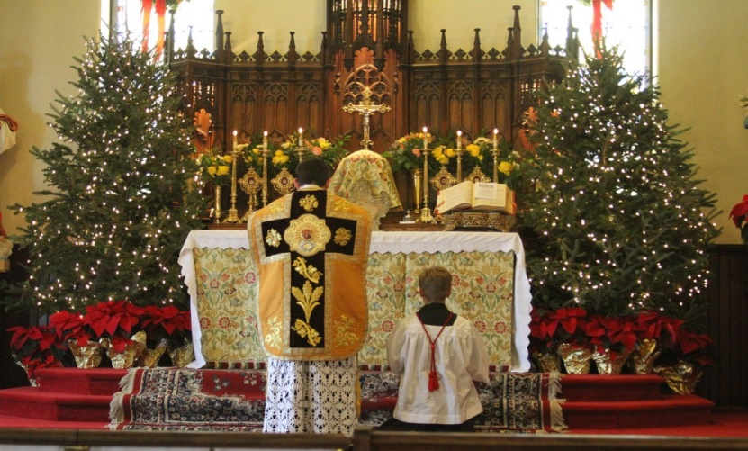
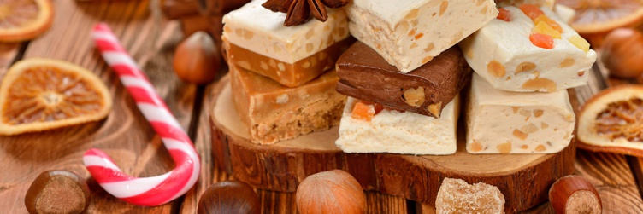
MISA DEL GALLO
TURRÓN

Slide 10
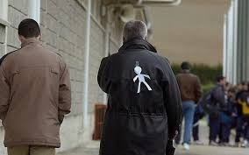
DÍA DE LOS SANTOS INOCENTES
On December 28, Spain celebrates el Día de los Santos Inocentes (Holy Innocents’ Day). This is another Catholic tradition that has evolved over time and been adapted to the modern world. Today, it is celebrated as a kind of Spanish April Fool’s Day when people play pranks (bromas o inocentadas) on each other. On this day, don’t believe everything you see or hear — chances are good that somebody’s pulling your leg.

Slide 11
NOCHEVIEJA
We’ve finally made it to December 31, the last day of the year. While Nochebuena (Christmas Eve) is celebrated as a family, Nochevieja (New Year’s Eve) is celebrated with friends.
After dinner and time for socializing, Spaniards spend the final moments before the clock strikes midnight preparing to ring in the new year. People gather in plazas or homes to eat the 12 uvas de la suerte (12 lucky grapes). During the last 12 seconds of the year, everyone eats 12 grapes so that luck will be on their side for the whole year to come. After midnight, the new year begins and people go out to celebrate it in style. For many, January 1 is a day to sleep in and recover from the night before.
But Christmas still isn’t over!

Slide 12
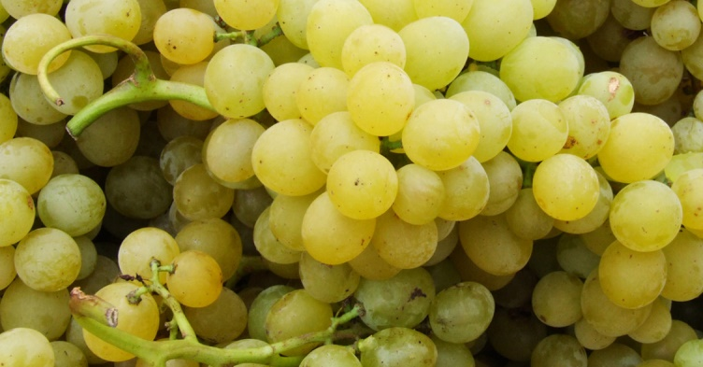
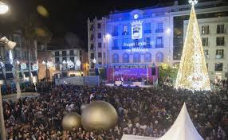
NOCHEVIEJA

Slide 13
The three wise men
January 5 is a very exciting day for the youngest members of a Spanish family. All afternoon, each city organizes a special event in which large floats parade through the streets carrying musicians, artists, people in costume, and, most importantly, the Tres Reyes Magos (the Three Kings), who wave to all the children of the city. After the parade, families return home for an early dinner so the children can clean their shoes and leave them in the living room. This way, when the Tres Reyes Magos visit the home in the wee hours of the morning, they’ll know where to leave the presents for each member of the family.
When they wake up on the morning of January 6, children across Spain jump out of their beds and run to the place they left their shoes the night before to see what gifts the Three Kings of Orient have left for them.

Slide 14
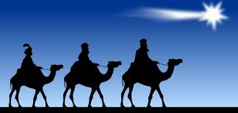
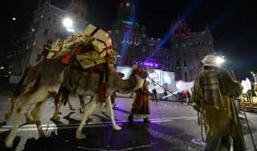
The three wise men

Slide 15
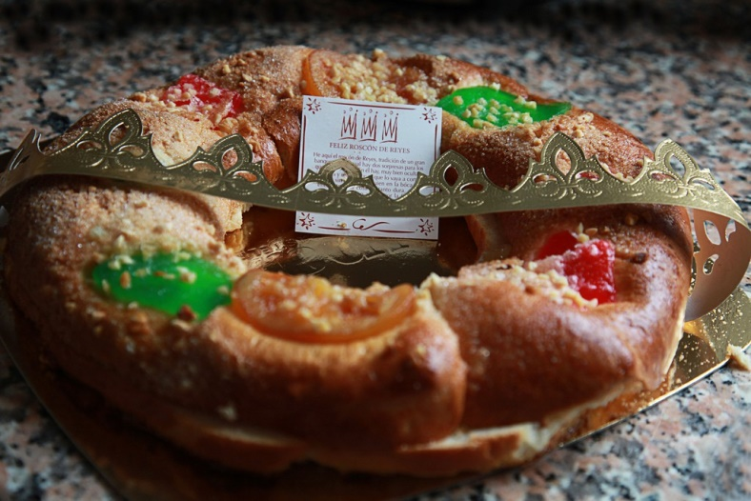
ROSCÓN DE REYES
Instead of Christmas cake or Christmas pudding, the Spaniards enjoy the Roscón de Reyes, usually on the Day of the Epiphany, on January 6. A sweet bread ring, it is topped with crushed almonds and candied fruits, and is sometimes stuffed with whipped cream. Sometimes a small figurine is hidden inside the bread, and the person who finds it has the honour of buying next year’s roscón.

