Slide 1
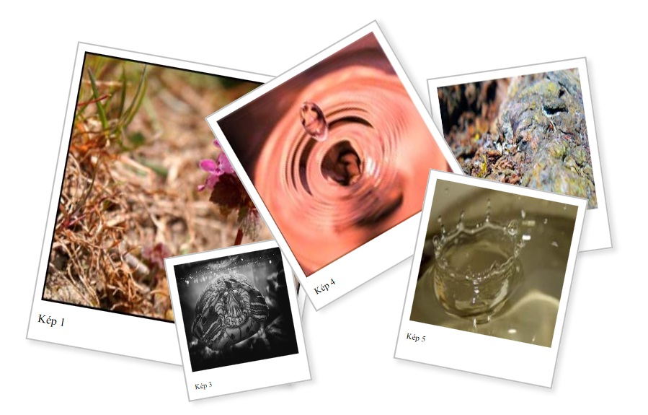
Hello!
Presentation by Ina Đorđević
What is slava in Serbia?
Traditions
Đurđevdan(St. George’s Day)
Slava is a feast held for relatives, neighbours and close friends. We celebrate an important holiday in honour of the patron saint.
Tradition #1
Tradition #2
St. George's Day: The most beautiful spring, Orthodox holiday
Photos

Slide 2
Since when do Serbs celebrate slava?
The term slava, made it’s apperance for the very first time in Ohrid, year 1018.

Slide 3
What is slava in Serbia?
To celebrate slava you need four the most important things- wine, celebration cake, candle and wheat.
On the day of the celebration, cake and wheat are taken to the church where they are consecrated and cut, but some families do the same at home.

Slide 4
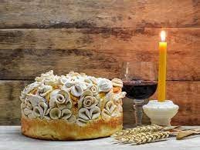
Traditions
In some parts, dinner is prepared on the eve of the celebration, which guests come to.
In some homes, if the priest comes, he consecrates the wheat and cuts the celebration cake. When the priest cuts the cake and pours the wine, then all the family members, led by the host, participate in turning the feast cake, singing church songs.

Slide 5
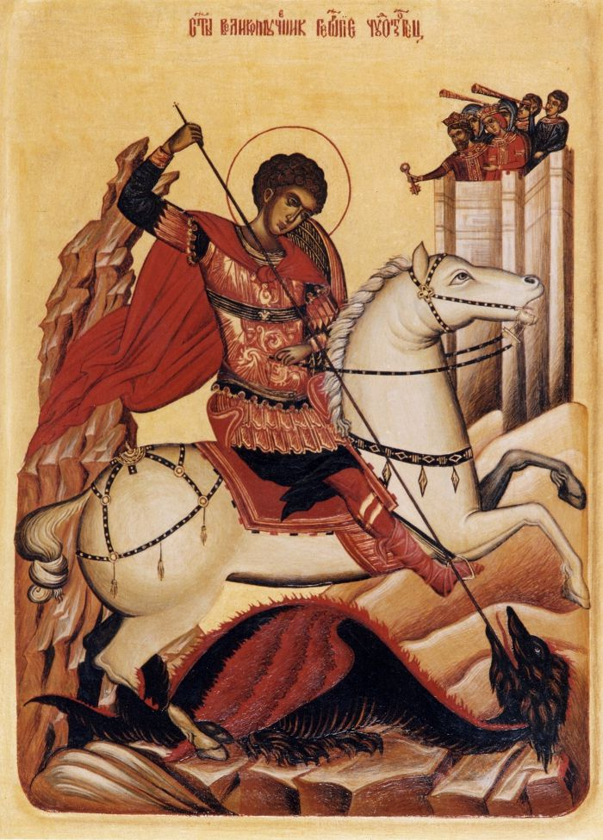
My family celebrates Đurđevdan.
Đurđevdan(St. George’s Day)
Đurđevdan is a Christian and national holiday that Orthodox believers celebrate on May 6 every year, in honor of St. George.
The customs for St. George's Day are weaving wreaths of herbs and washing with water in which medicinal plants were immersed.

Slide 6
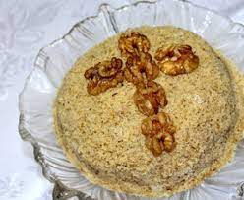
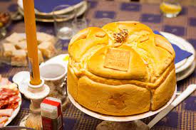
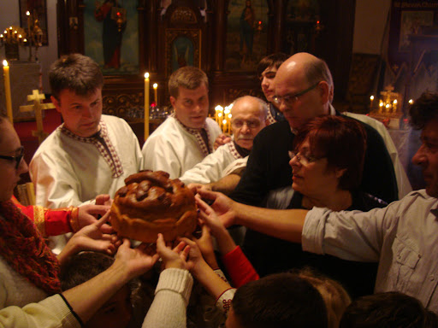
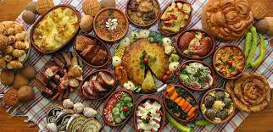
Photos

