Slide 1
Presentation about my slava st.Dimitrije

Slide 2
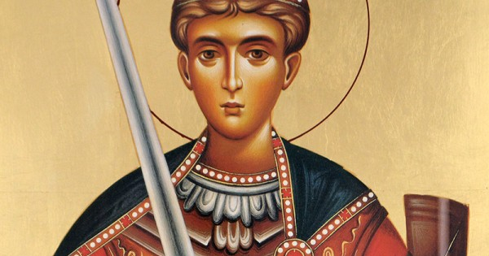
My slava is on 8.november and it is dedicated to Demetrius of Thessaloniki, the ancient commander of Thessaloniki, who suffered due to the spread of Christianity.

Slide 3
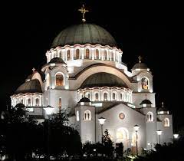
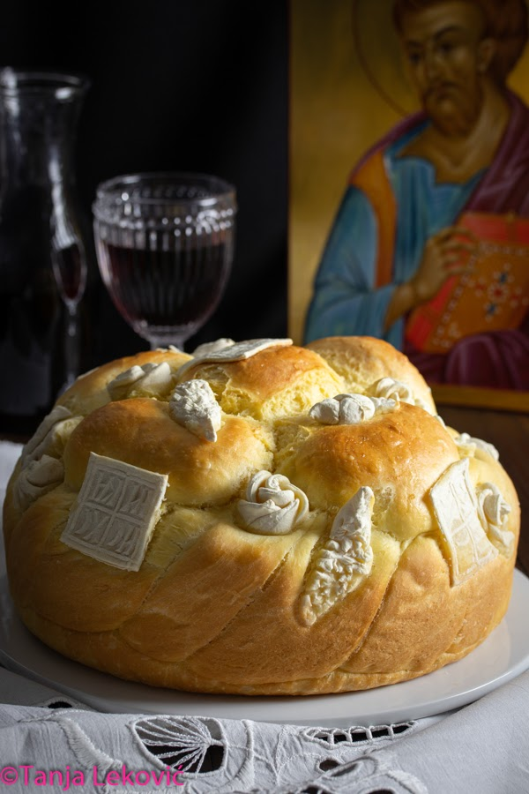
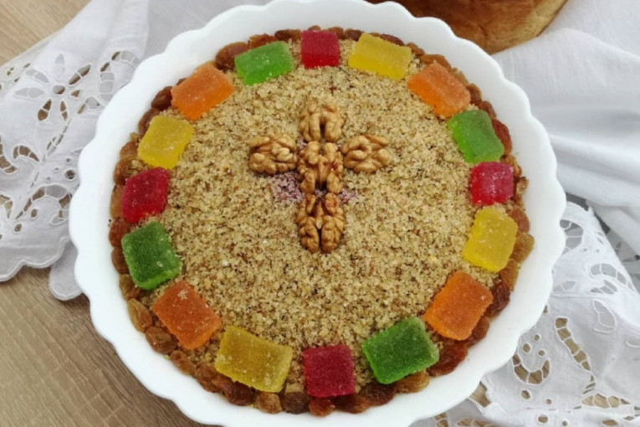
for slava we go to church early in the morning and with us we bring bread(slavski kolač) and we buy celebration candle and we make grain(žito).

Slide 4
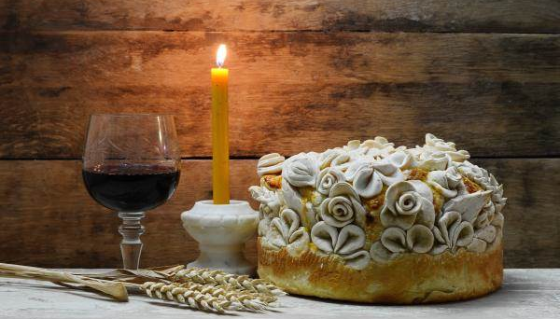

Slide 5
We have guests on slava.Which are usually our familly members and friends. They come over to house and then eat grain(žito) and after that they eat.

Slide 6
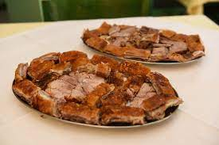
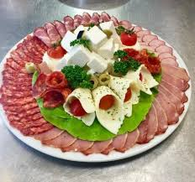
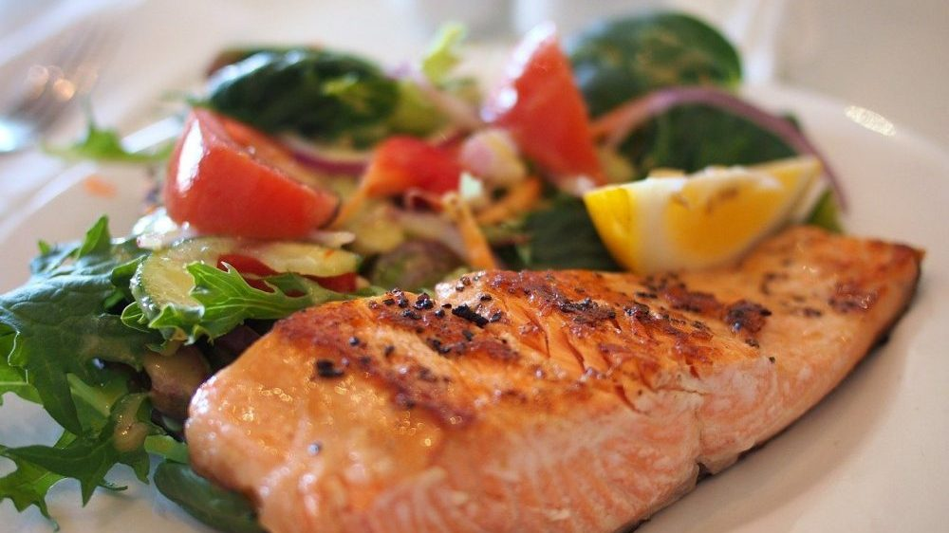
Here are some examples of food for slava

Slide 7
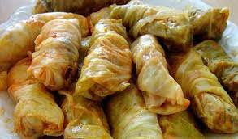
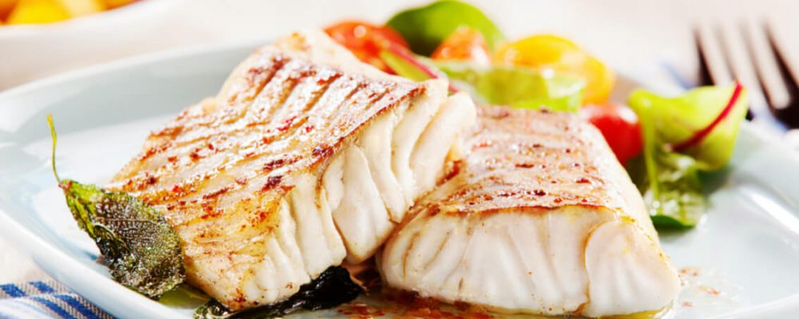
There are two kinds of slava. When it is on wendesday or Friday than we eat lean food like fish but when it is on any other day we eat meat and other food.

Slide 8
The end
Hope you enjoyed watching!
.
presentation by Jana Pantelić

