Slide 1
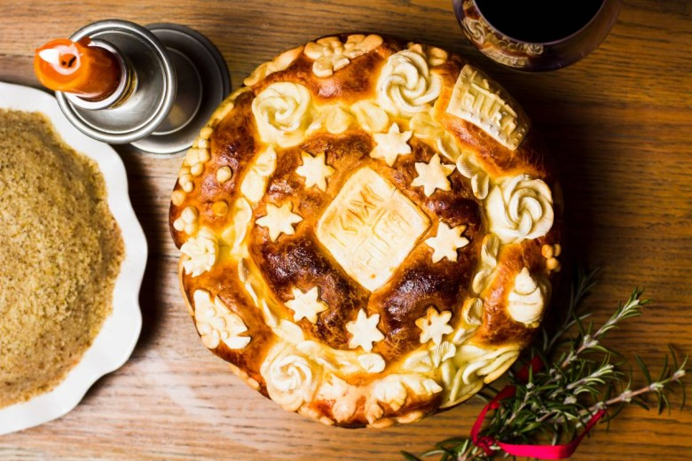
Slava (St Patron’s day)

Slide 2
My St Patron’s day is Sveti Jovan Zlatousti.

Slide 3
We allways buy a great vine named Zdrepceva krv.

Slide 4
Then my mom makes a tasteful grain with greaps and wallnuts.

Slide 5
And we maka big cake (bread) like this one.

Slide 6
This year’s Slava was a fasting one

Slide 7
My granny always comes first and I love it.
Then some of my uncles, aunts and cousins come.
Some of my cousins have the same Slava.
But we don’t celebrate it together.
Then my granny stays a few more days.

Slide 8
Happy Slava to all who will have it soon.

