Slide 1
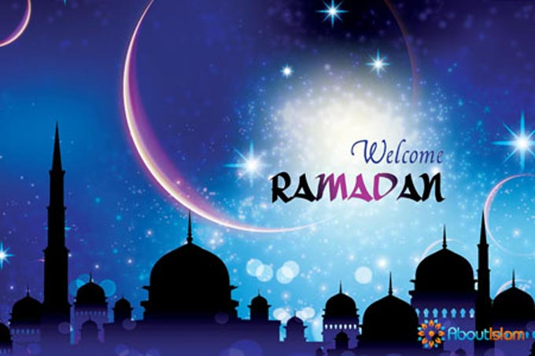

Slide 2
The month of Ramadan has got a huge place in Muslims lives.
It is the 9th month of Islamic calendar.
One of the necessities of Islam, religious fasting is carried out in this month.

Slide 3
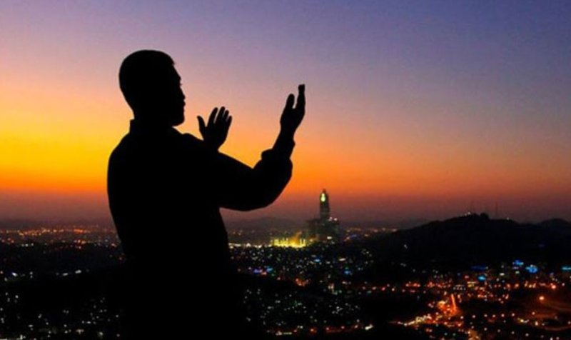
Meanwhile, the month of Ramadan is the period that the Quran was started recording.
The night that this process started is called "Qadr Night". It is started in the Quran that this night is more fortunate than thousands of months.

Slide 4
Ramadan is 30 days.
Every day fasting starts at sahur (a meal taken just before dawn during Ramadan) And finishes at iftar.
During daytime, We mustn’t eat and drink. Fasting means letting nothing pass the lips: no food, drink,

Slide 5
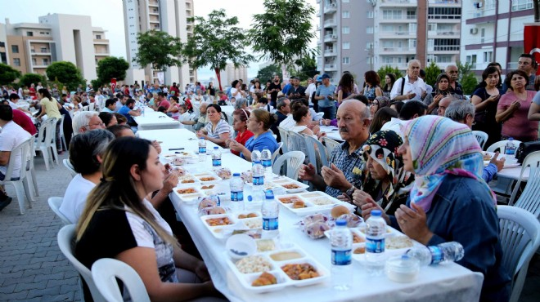
Ramazan is also a time of celebration, and after sunset the feasting begins with a ceremonial “break-fast” light meal called Iftar.

Slide 6
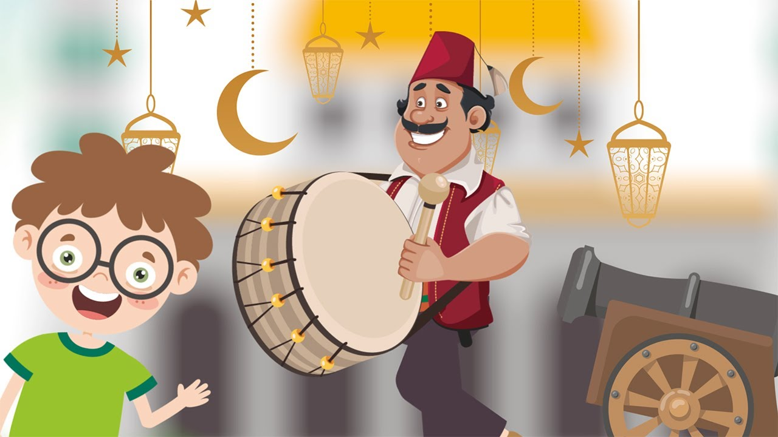
In the middle of the night, drummers walking on the streets.

Slide 7
Ramadan is the month of helping and sharing people each other.

